Slide 1
Unix System Administration
Unit 13: LDAP

Slide 2
LDAP
Lightweight Directory Access Protocol
  fast lookup via Internet
  low overhead
maintains directory information
  phone book
  email directory
  ...
example client programs
  email: Outlook, Thunderbird

Slide 3
LDAP
maintains directory information
  different kind of entries:
    root
    container
      root can serve as only container
    leaf
  each entry has an “objectclass”
  each entry has "dn:" distinguished name

Slide 4
objectclass examples
person
organization
also:
  top
  dcObject, organization
  inetOrgPerson
each objectclass defines attributes

Slide 5
objectclass
each objectclass defines attributes
  give entry detail
  some mandatory
objectclasses are arranged in hierarchy
  inetOrgPerson
    organizationalPerson
      person

Slide 6
attributes
attributetype ( 2.5.4.4
NAME ( 'sn' 'surname' )
DESC 'RFC2256: last (family) name(s) for which the entity is known by'
SUP name )
attributetype ( 2.5.4.3
NAME ( 'cn' 'commonName' )
DESC 'RFC2256: common name(s) for which the entity is known by'
SUP name )

Slide 7
attributes
attributetype ( 0.9.2342.19200300.100.1.1
NAME ( 'uid' 'userid' )
DESC 'RFC1274: user identifier'
EQUALITY caseIgnoreMatch
SUBSTR caseIgnoreSubstringsMatch
SYNTAX 1.3.6.1.4.1.1466.115.121.1.15{256}
)

Slide 8
attributes
attributetype ( 2.5.4.10
NAME ( 'o' 'organizationName' )
DESC 'RFC2256: organization this object belongs to'
SUP name )
attributetype ( 0.9.2342.19200300.100.1.25
NAME ( 'dc' 'domainComponent' )
DESC 'RFC1274/2247: domain component'
EQUALITY caseIgnoreIA5Match
SUBSTR caseIgnoreIA5SubstringsMatch
SYNTAX 1.3.6.1.4.1.1466.115.121.1.26
SINGLE-VALUE )

Slide 9
organization
objectclass ( 2.5.6.4 NAME 'organization'
DESC 'RFC2256: an organization'
SUP top STRUCTURAL
MUST o
MAY ( userPassword $ searchGuide $ seeAlso $ businessCategory $ x121Address $ registeredAddress $ destinationIndicator $ preferredDeliveryMethod $
telexNumber $ teletexTerminalIdentifier $
telephoneNumber $ internationaliSDNNumber $
facsimileTelephoneNumber $ street $ postOfficeBox $
postalCode $ postalAddress $
physicalDeliveryOfficeName $ st $ l $ description ) )

Slide 10
dcObject
objectclass ( 1.3.6.1.4.1.1466.344
NAME 'dcObject'
DESC 'RFC2247: domain component object'
SUP top
AUXILIARY
MUST dc )

Slide 11
inetOrgPerson
objectclass ( 2.16.840.1.113730.3.2.2
NAME 'inetOrgPerson'
DESC 'RFC2798: Internet Organizational Person'
SUP organizationalPerson
STRUCTURAL MAY (
audio $ businessCategory $ carLicense $
departmentNumber $ displayName $
employeeNumber $ employeeType $ givenName $
homePhone $ homePostalAddress $ initials $
jpegPhoto $ labeledURI $ mail $ manager $
mobile $ o $ pager $ photo $ roomNumber $
secretary $ uid $ userCertificate $
x500uniqueIdentifier $ preferredLanguage $
userSMIMECertificate $ userPKCS12 )
)

Slide 12
organizationalPerson
objectclass ( 2.5.6.7
NAME 'organizationalPerson‘
DESC 'RFC2256: an organizational person'
SUP person
STRUCTURAL MAY (
title $ x121Address $ registeredAddress $ destinationIndicator $
preferredDeliveryMethod $ telexNumber $
teletexTerminalIdentifier $ telephoneNumber $
internationaliSDNNumber $
facsimileTelephoneNumber $ street $
postOfficeBox $ postalCode $ postalAddress $
physicalDeliveryOfficeName $ ou $ st $ l )
)

Slide 13
person
objectclass ( 2.5.6.6
NAME 'person‘
DESC 'RFC2256: a person'
SUP top STRUCTURAL
MUST ( sn $ cn )
MAY (
userPassword $
telephoneNumber $
seeAlso $
description )
)

Slide 14
example entry: top node
dn: dc=instructor,dc=ege,dc=com
objectclass: organization
objectclass: dcObject
dc: instructor
o: instructor.ege.com

Slide 15
example entry: leaf
dn: uid=ege,dc=instructor,dc=ege,dc=com
objectclass: inetorgperson
mail: ege@instructor.ege.com
uid: ege
sn: Ege
cn: Raimund Ege

Slide 16
ldap server setup
Install rpm package
  yum install openldap-servers
check run-level service
  chkconfig ldap on
check firewall
  enable iptables tcp port 389
configuration file: /etc/openldap/slapd.conf
database bdb
suffix "dc=instructor,dc=ege,dc=com"
rootdn "cn=Manager,dc=instructor,dc=ege,dc=com"
rootpw secret
directory /var/lib/ldap
start service: service ldap start

Slide 17
ldap client utilities
configured via /etc/openldap/ldap.conf
  HOST 127.0.0.1
  BASE dc=instructor,dc=ege,dc=com
ldapadd
  ldapadd -c -x -w secret
  -D 'cn=Manager,dc=instructor,dc=ege,dc=com‘
  -f init.ldif
ldapsearch
ldapdelete

Slide 18
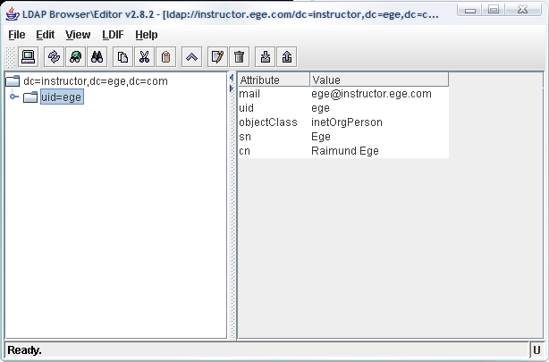
ldap browser
http://www-unix.mcs.anl.gov/~gawor/ldap/download.html

